Slide 1
October 25, 2014

Slide 2
Quote of the month:
“I’ve always believed that you just do the best job you possibly can at whatever you’re given to do, and the rest of the future will take care of itself. That was the way I was raised, and that’s the way it worked out.”
Rex Tillerson
President, Chairman, CEO ExxonMobil Keynote Speaker 2014 Eagle Scout Recognition Dinner
Notes:
The General Commission on United Methodist Men, meeting Sept. 5-7, is seeking ways to reverse the loss of nearly 16,000 young people.
The bishop said efforts to increase the number of young people in churches must begin with children. He called for a new emphasis on Cub Scouts and Daisies from the Girl Scouts . “You can’t get youth without beginning with children,” he said.

Slide 4
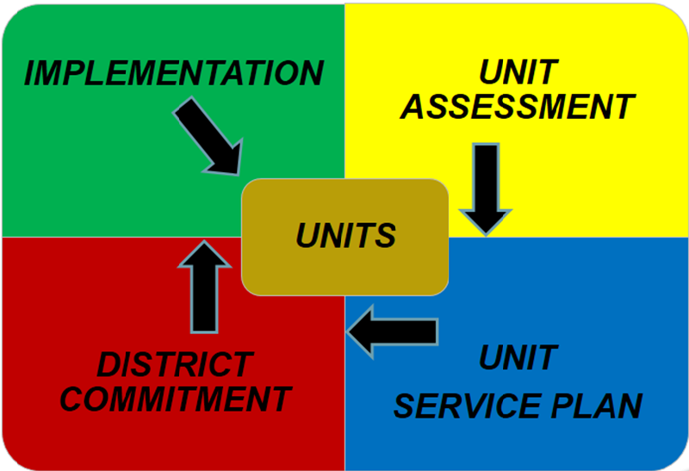
The Unit Service Plan

Slide 5
Commissioner Tools
All Commissioners on my.Scouting.org
Attend webinars
November dates available
Communicate/Educate
District Key 3
Unit and Administrative Commissioners
Roundtable Commissioners
Training
Schedule Dec 1
No more UVTS!
January Assessment use new process!

Slide 6
COMMISSIONER General Updates

Slide 7
#1 Priority
DC Goals:
32 recruited; need 55 more
Using Commissioner Report:
September 2014– Need 39
Notes:
3 New Commissioners in Mingo Trails!

Slide 8
2014 Priorities District Commissioner
Recruit Unit Commissioners
Recognize effective commissioners
Improve unit visitation

Slide 9
Journey to Excellence

Slide 10
Journey to Excellence

Slide 11
Charter Renewal
100 % On Time!!!!
(Status reports next month)

Slide 12
Annual Service Plan
November
Youth Protection Visit
December
Charter Renewal
JTE Measurements
January
District Evaluation
Unit Assessment
http://commissioner-bsa.org/service.html

Slide 13
Looking Ahead
Save-A-Scout!!!!
Set Dates
Recruit Team
Plan to Succeed
13

Slide 14
Corrections
Area 4 Key Leadership Conference November 15, 2014 @ IUP
Latest issue of Scouting Safely

Slide 15
Career Enhancement
Should the unit commissioner know everything about each unit’s operation?
While it would be nice, it isn’t necessary.
It is important, however, to know how to deal with common problems, and it is absolutely necessary to know where to get help with the special problems.
The commissioner must care enough to never let a question go unanswered or a problem unresolved.
That is the final test of a good unit commissioner.
Council Commissioner Manual #522-015

Slide 16
COMMISSIONER Training Updates
Jack Boyde
Assistant Council Commissioner – Training & Recognition

Slide 17
Commissioner Conference
June 14 Camp Guyasuta
Extrordinary Speaker
Advanced Training
Barbecue Ribs or Chicken Dinner
Team Building & Fun
DCSA Presentation
June Cabinet Meeting

Slide 18
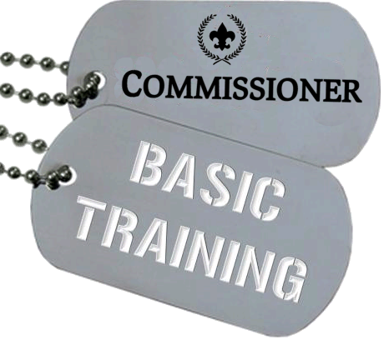
COMMISSIONER Training Updates
Report on Oct 4 Training
Hosted by Area 3

Slide 19
COMMISSIONER Training Updates
December 13 – Sponsored by Area 2 8:30 AM @ Flag Plaza (Can be simulcast to Ebensburg or Cumberland)
February 14 – Area 2 (Location TBD)

Slide 20
COMMISSIONER Training Updates
March 21, 2015

